Slide 1
PREVENTING SUBSTANCE-RELATED HARMS AMONG YOUTH THROUGH A COMPREHENSIVE SCHOOL HEALTH APPROACH
A BLUEPRINT FOR ACTION – AN INTRODUCTION

Slide 2
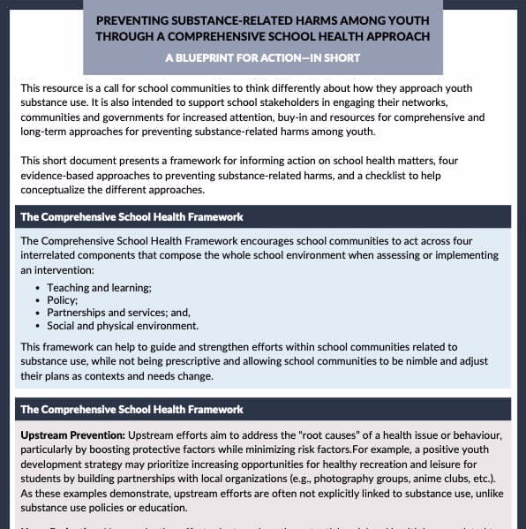
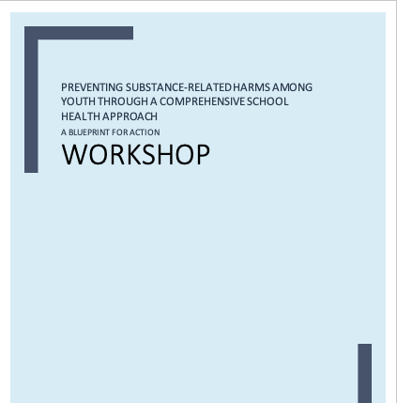
This presentation will cover…
What is the Blueprint for Action?
Exercise to apply the Blueprint for Action
Products and tools to implement the Blueprint for Action

Slide 3
WHAT IS THE BLUEPRINT FOR ACTION?
What is it?
Purpose
Developed by The Public Health Agency of Canada
Informed by over 50 diverse school stakeholders at the School Matters Forum.
Brings together:
The Comprehensive School Health Framework.
Four Intervention Strategies.
To inform comprehensive and concrete action plans and strategies.
To encourage a different way of thinking about how to approach youth substance use.
To support school stakeholders to engage their networks.

Slide 4
THE PREVENTION OF YOUTH SUBSTANCE-RELATED HARMS
Substance use is associated with a range of potential harms.
Youth are more vulnerable than adults to substance-related harms.
Substance use is “risky”; however, these risks are not fixed.
Substance-related harms are influenced by social and structural factors.
Substance-related harms can be reduced through harm reduction.

Slide 5
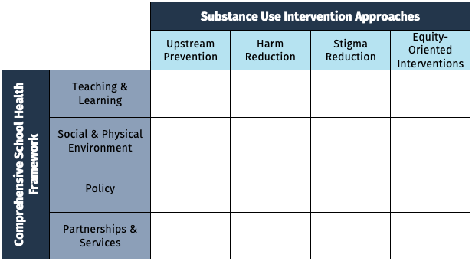
BRINGING TOGETHER THE COMPREHENSIVE SCHOOL HEALTH FRAMEWORK AND FOUR INTERVENTION STRATEGIES
The model supports school community members to plan and implement strategies to prevent substance-related harms among youth that:
Are grounded in evidence.
Reflect students’ diverse needs and experiences.
Maximize levers within school communities.

Slide 6
1. THE COMPREHENSIVE SCHOOL HEALTH FRAMEWORK
Holistic approach to build healthy school communities.
Should act across four interrelated components when assessing or implementing an intervention:
Helps to guide and strengthen efforts, while not being prescriptive, and to adjust their plans as contexts and needs change.
Helps to think through how to translate conceptual approaches into practical and concrete school-based actions and identify the assets and gaps within the school community.
Teaching & Learning
Policy
Partnerships and Services
Social & Built Environment

Slide 7
IN A NUTSHELL…
Evidence-based substance use education is one component of a comprehensive approach for preventing substance-related harms among youth.
Other important levers: Policy, Social and Built Environment, as well as Partnerships and Services.

Slide 8
2. THE FOUR INTERVENTION STRATEGIES
Much of the available literature and resources on school-based initiatives related to youth substance use focus solely on one particular intervention approach = a useful, but relatively narrow, perspective.
In contrast, the Blueprint for Action is designed to showcase several evidence-based approaches, outline the many ways they can be carried out within school communities and describe how initiatives can fit together.
Let’s take a closer look at the four intervention strategies.
Upstream prevention
Stigma reduction initiatives
Harm reduction
Equity-oriented interventions

Slide 9
2. THE FOUR INTERVENTION STRATEGIES: UPSTREAM PREVENTION
Address the root causes of health issue or behaviour.
Often not explicitly linked to substance use.
Minimizing
Boosting
Protective factors
Risk factors

Slide 10
2. THE FOUR INTERVENTION STRATEGIES: HARM REDUCTION
Aim to reduce the potential social and health harms without promoting or requiring non-use.
This strategy aims to get AWAY from an abstinence-based approach.
Support healthy behaviours without “forcing” them.
Meeting people where they are at is an important aspect.
Celebrate small positive changes in behaviour.

Slide 11
2. THE FOUR INTERVENTION STRATEGIES: STIGMA REDUCTION INITIATIVES
What is stigma?
Negative stereotyping of people
Creates an US vs. THEM dichotomy
Aim to make a space for open, informed and non-judgmental conversations about substance use.
Create opportunities to exchange credible, practical information and advice.
Help to enhance socio-emotional assets and skills:
Empathy, sensitivity and compassion
By reducing stigma, we are promoting inclusion and making students feel comfortable sharing their experiences.

Slide 12
2. THE FOUR INTERVENTION STRATEGIES: EQUITY-ORIENTED INTERVENTIONS
What is equity?
The quality of being fair and impartial, both in process and in results.
Equity vs equality?
Seek to make institutions and systems more accessible, responsive, compassionate and safe for ALL people.
Develop policies, programs and interventions that reflect individual’s diverse needs, preferences and life experiences.
Two examples of intervention strategies:
Cultural safety practice
Trauma-informed and violence-informed (TVI) practice

Slide 13
IN A NUTSHELL…
The best prevention measures often have nothing to do with substance use at all.
Improving overall health and well-being
Reducing social and health inequities
Efforts to prevent substance-related harms among youth must reflect individual school communities’ unique needs, values, preferences and contexts.
Engage with: teachers, families, school health nurses, other school staff, and youth themselves.

Slide 14
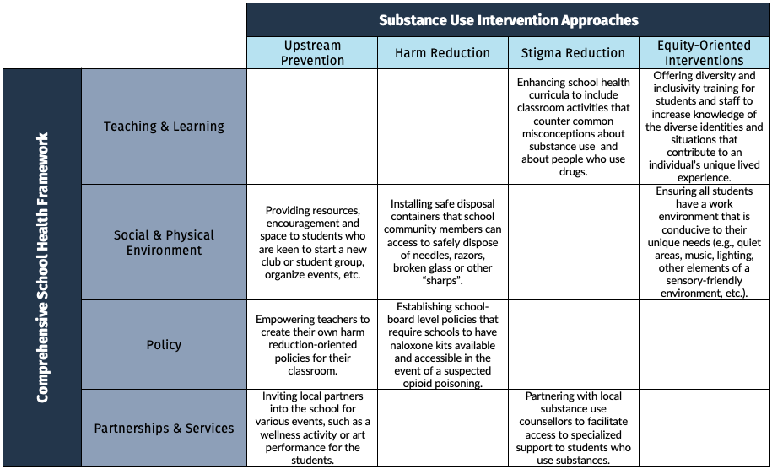
THE BLUEPRINT FOR ACTION: COMBINING THE INTERVENTION APPROACHES
These elements may appear mutually exclusive, but they have more similarities than it looks:
They share the same value: Compassion, Equity and Responsiveness.
They can look the same in practice.

Slide 15
WHY IS THE BLUEPRINT FOR ACTION RELEVANT FEASIBLE AND ACTIONABLE?
The model is relevant, feasible and actionable because:
It affords greater reach and relevance to youth compared to “one-size-fits-all” models.
When applied in combination, the model building blocks can support and reinforce each other.
The four intervention approaches have broad relevance.
The model can contribute to a range of positive outcomes for school communities.
The model reflects a much-needed shift away from the status quo.

Slide 16
LET’S LOOK AT AN EXAMPLE…

Slide 17
SCENARIO 1
Riley’s attendance is very poor. However, they consistently attend noon hour pick-up basketball in the gym. One day, the vice-principal comes to the gym, notices the student playing basketball, and proceeds to tell Riley that until their class attendance improves, they are not allowed in the gym.
Shortly after, Riley’s friend Avery speaks to a school support staff and says they are worried about Riley. Avery shares that Riley has been using substances lately, and Riley notices that playing basketball makes them feel like not using the substance. Avery says Riley isn’t at school because when they attend class, their feeling to use substances increases. Riley told Avery they are not so “good in school” so they feel “stupid”, but when they play basketball, they feel “competent”.
How can we help the student who is attending infrequently/using substances when it didn’t come directly from them?

Slide 18
How can the various approaches be used to support this situation?
UPSTREAM PREVENTION
HARM REDUCTION
How can we identify the barriers that this student may face in regards to their attendance?
Why are students missing classes in the first place?
What are additional ways in which the school can support participation in basketball programs?
What policies are in place to encourage attendance rather than punish absenteeism?
How can we use the student’s interests to shift their attendance?
Where in your school can students receive or gather information featuring harm reduction messaging?

Slide 19
How can the various approaches be used to support this situation?
STIGMA REDUCTION
EQUITY-ORIENTED LENSE
How can policies be developed that aim to connect students and other members of the school community with support related to their substance use, mental health or other aspects of their health and well-being?
How does stigma impact students in your school?
How can we make sure the students can seek academic support without feeling stereotyped?
Is it possible that the student is not feeling a sense of belonging?
How can we support students with increasing their sense of belonging in the school?
What tools could be provided to the students to ensure an optimal environment for learning and studying and to meet the student’s unique needs?

Slide 20
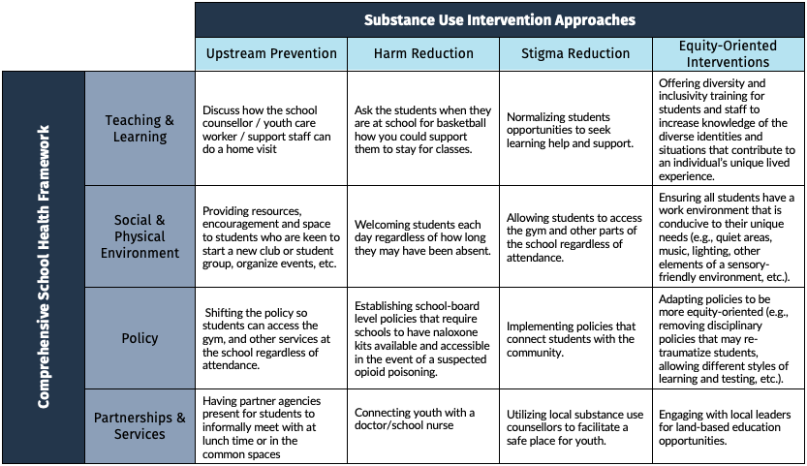

Slide 21
IN A NUTSHELL…
Many traditional approaches to addressing youth substance use (e.g., zero tolerance policies, abstinence-only education, etc.) have limited effectiveness and can produce unintended negative consequences.
School communities should use the best available evidence to:
Inform their efforts to prevent substance-related harms.
Evaluate these initiatives on an ongoing basis.

Slide 22
SOME RESOURCES AVAILABLE: THE SUMMARY
There are a few products and tools that we developed with the Student’s Commission of Canada to help you implement the Blueprint for Action.
THE SUMMARY: One-pager presenting an overview of the Blueprint for Action.
Offers a good hands-on reminder of this model.
Offers a simple product that you can share with your colleagues or your network.
Includes a checklist for self-evaluation.

Slide 23
SOME RESOURCES AVAILABLE: THE INFOGRAPHIC
There are a few products and tools to help you implement the Blueprint for Action.
THE INFOGRAPHIC: visual document presenting an overview of the Blueprint for Action in brief sections.
Offers a good visual to present this model to your team, your colleagues, or your network.
Offers a simple and brief overview, which focuses on the general elements you should remember.
Includes a series of scenarios and questions to help people think critically about various situations in which the Blueprint for Action could be implemented.
Two formats available: an online dynamic infographic and a downloadable version.

Slide 24
SOME RESOURCES AVAILABLE: THE WORKSHOP
There are a few products and tools to help you implement the Blueprint for Action.
THE WORKSHOP: a three-hour training session exploring the Blueprint for Action in depth.
Offers a good and detailed explanation of this model, the various principles and the best practices to implement it.
Includes theoretical and practical sections to help you and your school community to gain a good understanding of the Blueprint for Action.
Comes with a slide deck for visual support and a facilitator guide.
Train the trainer sessions will be led across Canada by the Student’s Commission of Canada in Fall 2021 and Winter 2022

Slide 25
Thank you for attending
PREVENTING SUBSTANCE-RELATED HARMS AMONG YOUTH THROUGH A COMPREHENSIVE SCHOOL HEALTH APPROACH
A BLUEPRINT FOR ACTION – AN INTRODUCTION

